Slide 1
White Rock
Yuki
BC2406 Analytics I: Visual and Predictive Analytics
Presentation by:
Ng Chi Hui (U1922243C)
Josiah Goh (U1810793E)
Jarrel Kong Kai Jit (U1910901J)
Wang Liang Yi (U1920597H)
Shaun Leow (U1921323A)
Yuki Yap (U1910716A)
Notes:
Good evening Prof! My name is Yuki from Team 6 and my group members are Chi Hui, Josiah, Jarrel, Liang Yi and Shaun. Today, we will sharing with you our project analysis on White Rock.

Slide 2
Content
01
02
03
04
Yuki
Introduction
Business Recommendations
Problem Statement
Problem Approach
Increasing Inflow : Mapping Relationships, Robo Advisor
Decreasing Outflow : Identifying Churn
Data Visualisation Models
Conclusion
CART
Linear Regression
Summary
Questions
Notes:
The content flow is as follows: I will be going through the introduction, Jarrel, Josiah, Chi Hui and Liang yi will be sharing with us the business recommendations, Shaun will be presenting the data visualisation models and I will be concluding the presentation.

Slide 3
01
INTRODUCTION
Yuki
Notes:
Without further ado, let’s dive right in.

Slide 4

Problem Statement
Yuki
How can we increase AUM for White Rock?
Notes:
For our project, we have centered our analysis and models based on our problem statement which is “How can we increase AUM for white rock?”.

Slide 5

Considerations
Yuki
Considering that:
White Rock is an investment company and asset manager.
2. White Rock and its peers make most of their revenue through management fees.
3. White Rock collects a lot of data regarding their operation and sales.
Notes:
Some considerations that we have made are that:
White Rock is an investment company and asset manager.
White Rock and its peers make most of their revenue through management fees.
White Rock collects a lot of data regarding their operation and sales.

Slide 6

Business Solutions
Yuki
One of the most important measures of success of asset management firms like White Rock is assets under management(AUM).
A steadily growing AUM annually indicates growth prospects for the firm.
There are 3 main ways to increase AUM:
New investments from new/existing customers or increasing inflows
2) Retaining investments from existing customers or reducing outflows
3) Higher returns from existing AUM
Notes:
We believe that one of the most important measures of success of an asset management firm like White Rock is assets under management(AUM). This is because a steadily growing AUM annually signals growth prospects for the firm.
We have also found out that there are 3 main ways to increase AUM, namely:
New investments from new/existing customers or increasing inflows
Retaining investments from existing customers or reducing outflows
Higher returns from existing AUM

Slide 7

Decision Making
Yuki
Unwise to rely solely on investment returns to increase AUM which can vary widely from year to year depending on how risky the investment is.
A more reliable approach would be to win new investments from new or existing customers and to retain as much of their investments as possible.
Notes:
However we think that it is unwise to rely solely on investment returns to increase AUM which can vary widely from year to year depending on how risky the investment is. And a more reliable approach would be to win new investments from new or existing customers and to retain as much of their investments as possible.

Slide 8


Business Solutions
Yuki
Therefore, we will only be focusing on 2 main ways in this proof of concept (POC).
Increasing Inflow
Decreasing Outflow
Notes:
Therefore, we will only be focusing on 2 main ways in this proof of concept (POC). Namely, Increasing inflow and decreasing outflow.

Slide 9

Dataset Used
Yuki
Analysis and recommendations will be given based on a similar dataset that we would expect from White Rock.
This is accompanied by investor demographics and their portfolio information.
Ensure that the models that we use will be relevant to White Rock.
Notes:
Our analysis and recommendations will be given based on a similar dataset that we would expect from White Rock. This is accompanied by investor demographics and their portfolio information. This helps to ensure that the models that we use will be relevant to White Rock.

Slide 10
02
BUSINESS RECOMMENDATIONS
Jarrel

Slide 11



Increasing Inflows - Mapping Relationships
Jarrel
Age
Gender
No. of Dependents
Notes:
The first method to increase inflows involves mapping the relationships between our investors and the investment vehicles they invest in. From our analysis, we have identified 3 ways of segmentation to help us map this relationship. They are, age, gender and the no. of dependents of our clients.

Slide 12
Insights
Jarrel
↑Age:↑Gold
Female:↑Corp Bonds
Male:↑EMF
↓Age:↑ETF Tech
↑Dependents:↑PE
↓Dependents:↑Govt. Bonds
Notes:
Based on our analysis, clients who are older in age tend to invest more in gold, whereas, clients who are younger tend to invest more in ETF Tech. Clients who have more dependents invest more in Private Equity and those with less dependents invest more in Government Bonds. Female clients also invest more in corporate bonds and male clients invest more in EMF.

Slide 13
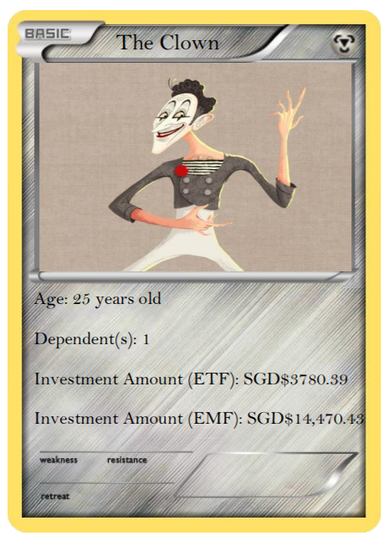
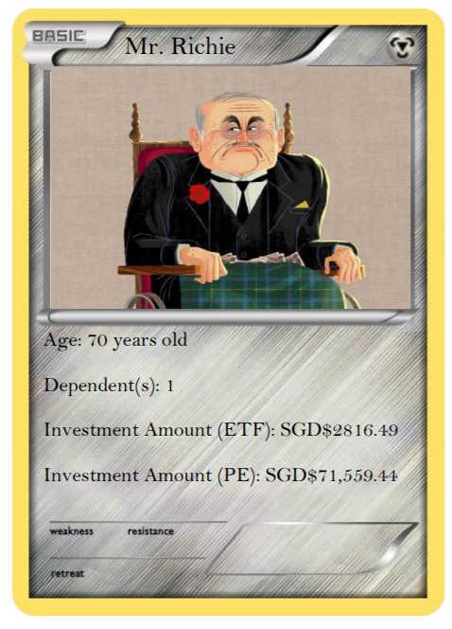
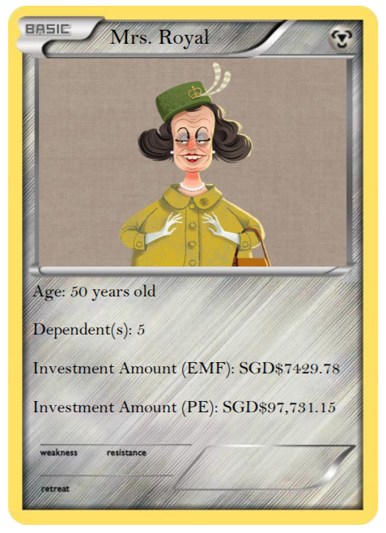
Insights
Jarrel
Difference: $963.90
Difference: $7040.65
Difference: $26,171.71
Notes:
This can be better illustrated through the mock profiles of these investors, where the values for their respective investments are predicted using our models. The Clown being a younger investor invests $963.90 more than Mr richie in ETF Tech who is an older investor. Mr richie, who has only 1 dependent invests $26,171.71 less in Private Equity as compared to Mrs Royal who has 5 dependents. Mrs Royal, being female, also invests $7040.65 less in EMF compared to the Clown.

Slide 14
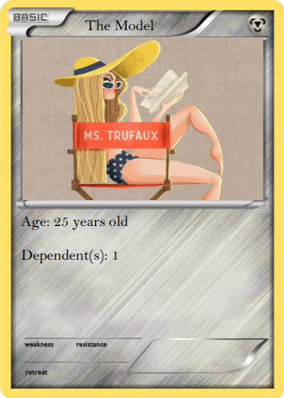
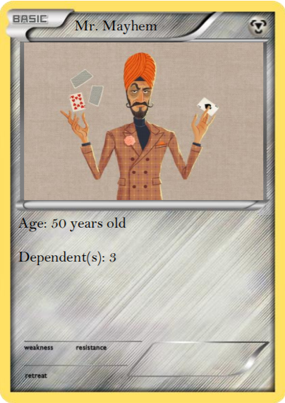
Action
Jarrel
ETF Tech
$3780.89
Gold
$7064.65
Corp. Bonds
$12,433.86
EMF
$14,470.43
Govt. Bonds
$29,019.30
Priv. Equity
$79,715.27
Notes:
So, let us say, there are 2 new clients who have decided to invest with us. The first is a 25 year old female who has 1 dependent; we can suggest to her products that fit her profile, such as ETF Tech, Corporate Bonds, and Government bonds, of which we expect her to invest $3780.89, $12,433.86, and $29,019.30 for each of the funds respectively based on our model. The second is a 50 Year old male who has 3 dependents. Based on his profile, we can then suggest the purchase of Gold, EMF, and Private Equity, of which we expect him to invest $7064.65, $ 14,470.43, and $79,715.27 for each of the funds respectively based on our model.

Slide 15
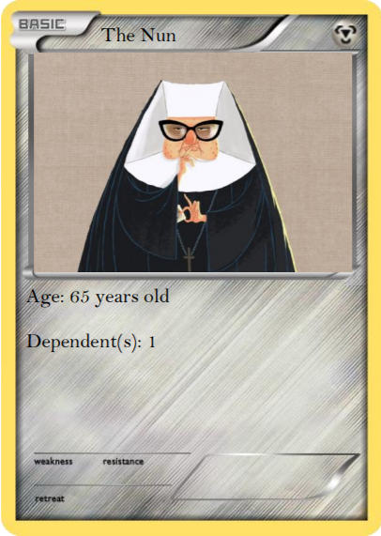
Limitations
Jarrel
“Women more likely than men to delay retirement”
- Caitlin Mullen (BizWomen, 2020)
Notes:
While our model does provide some guidance and suggestions on types of products and amounts to be invested based on the client profile, there may be certain outliers or special cases which may not fit our model. For example, we found a study done which states that women are more likely than men to delay their retirement, and this is largely in part due to financial reasons. As such, if there is a female client who is near retirement age, looking to grow her retirement fund, an investment in a low risk, low return product, like corporate bonds may not be as suitable even though it fits her profile. We may need to recommend investments that may give higher returns, even if they may be a little riskier, such as EMF or Private Equity. Our model provides a good basis for us to advise clients accordingly, but there will definitely be some clients who may not fit in the mould, and may require advice that falls outside of our model.

Slide 16
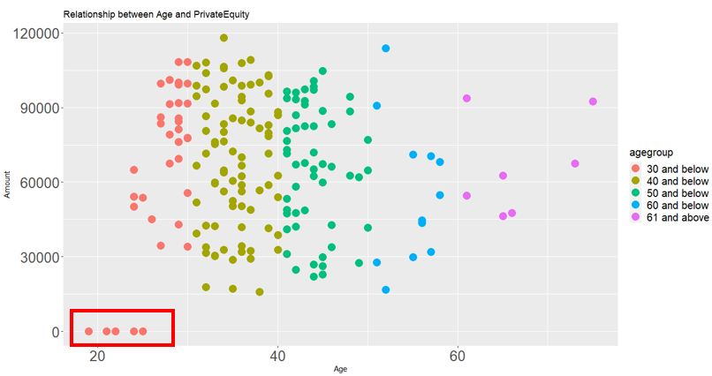
Increasing Inflows- Robo Advisors
Josiah
Minimum investment amount in PE: $250,000 to millions
Notes:
As for the second method to increase inflows, we have found some outliers, in a bivariate distribution between Age and Private Equity investment amounts. These outliers appear to be in the range of 30 years old and below. One possible reason is that there are high minimum sums ranging from $250,000 to millions to invest in PE funds and these young people are likely not to have salaries high enough to invest. White Rock can use this opportunity to target them.

Slide 17





Increasing Inflows- Robo Advisors
Josiah
Notes:
We recommend White Rock to create a robo advisor application to target these outliers and allow them to have some exposure to the PE market. This way, the company is able to pool the money together to meet the high minimum investment amounts as mentioned earlier. Additionally, this allows the company to ride on the technological wave, where the younger people are more tech inclined and receptive to new ways of investing.

Slide 18



Benefits
Josiah
Easy to rebalance investment portfolios
Automate tax-loss harvesting
Decrease labour costs, as staff can liaise with their customers through electronic means
Notes:
There are a few benefits for White Rock in this. Firstly, White Rock will just need to create and maintain the various functions in the roboadvisor to rebalance the portfolio. Secondly, labour costs can be reduced as the company can decrease the number of staff handling the portfolio since roboadvisor provides them electronic means of liaising with their customers. Lastly, it can help white rock not conduct tax-loss harvesting manually as conditions can be set to buy or sell certain similar assets, which drop in value to balance out increases on other investments. Therefore, at the end, overall tax liability is reduced

Slide 19
Costs
Josiah
Total Mobile Application Cost
Startup Mobile Application Development Cost | Annual Maintenance Cost
$270,000 | $54,000
*These costs do not include all variable expenses such as marketing and sales costs to drive application adoption by White Rock customers
However, in the long run:
Speed up due diligence processes
Centralise management system
Notes:
Despite the benefits of a robo advisor, in the short term White Rock has to invest large sums to begin. It has to invest in various resources such as application developers to create and maintain the application. It is projected that the company will spent 270k to kick start it and 54k to maintain it annually.
However, the company will be able to speed up due diligence processes and bring in customers into the system quickly. It can also centralise customer management and change across its various business units.

Slide 20
Implementation Guidelines
Josiah
Charge low management fees (~0.375%)
Allow for a “no minimum” investment amount
Set up onboarding surveys to find out each investor preferences
Create different tiers of service based on portfolio amount
> Investments above $100,000 can have 4 reviews per year with a
dedicated advisor
Notes:
Here are some guidelines to implement the roboadvisor application. Firstly, to make this attractive for young investors, White Rock should charge low management fees around 0.375% as compared to the other financial instruments and allow for a no minimum amount for investment. This make it easier for the target group to invest with their lower salaries. Next, it should create onboarding surveys to find out these investors’ preferences, whether do they have conservative or risk appetite. White Rock can also create different tiers of serviced based on the amount invested. For example, customers with investments above $100,000 can have 4 reviews per year with a dedicated advisor.

Slide 21






Implementation Schedule
Planning
Application Design
Application Development
Support & Maintenance
& Update
Josiah
Jan 2021
2-3 Weeks
Feb 2021
2-3 Weeks
March 2021
3-4 Weeks
April 2021
6-8 Weeks
June 2021
6-8 Weeks
August 2021
2-3 Weeks
Approval obtained &
Business Analysis
UX Design
UI Design
Back-End Development
Front-End Development
Testing
&
Launched
Notes:
Assuming White Rock accept this idea, this is the proposed implementation schedule starting from January next year. This comprises of main 3 phases, planning, application design and application development. It will take approximately around 9 months for the application to be rolled out to consumers.

Slide 22

Impact
Chi Hui
Assuming:
Each young investor in White Rock invest $5000 at annual management fees of $18.75 (0.375%)
Investopedia survey 2019:
20% are currently
using a robo advisor
Annual break even point in customers acquired: 2,880
Annual AUM inflow increase: $14,400,000
Notes:
In 2019, investopedia has conducted a survey, asking young investors about using robo advisors. Results showed that 20% are using it.
If we were to reflect this amount 20% to white rock, assuming each young investor invest $5000 annually with management fees of $18.75, which is around 0.375%, White Rock will just need to have 2,880 investors to cover the fixed costs of this application annually. In the end, White Rock will also have around 14 million of inflow per year.
Roboadvisor can be used to mainly target young investors but can be offered to other groups of investors, who may want exposure to the PE market on a case by case basis as mentioned by Jarrel definitely.
This is definitely one of the best ways to increase inflows for the company.

Slide 23

Decreasing Outflows- Identifying Churn
Chi Hui
Most likely to churn conditions :
Number of days since last transaction is more than or equal to 201 days
2. Annual salary of less than $159k
Cart Model
71% Accuracy

Slide 24
Decreasing Outflows - Possible Explanations
Chi Hui
Conditions
Number of days since last transaction >= 201 | Annual salary < $159k
Irrelevant Products | Feel underserved as compared to customers with higher income
Not as good as competitors | Products not tailored enough
Lack engagement

Slide 25
Decreasing Outflows - Possible Solutions
Liang Yi
2 pronged approach
Automated | Human touch
1. Set a predetermined cut-off eg. 50 days before customers reach 201 days of inactivity | 1. Have in depth conversations with this group of customers to find out the root cause(s)
2. The system will automatically identify customers at high risk of churning(those at 151 days of inactivity and annual salary < $159k) | 2. Make necessary changes that will address the issues faced. For eg. if they commonly cite irrelevant products then we will need to come out with more relevant products
3. Engage them in low touch ways eg. send push notifications to remind them to continue with their investment plans
A/B test whatever approaches we implement to see if it’s effective

Slide 26
Decreasing Outflows- Impact
Liang Yi
Average amount of assets each churned customer had | $118,861
Assume average management fee charged is | 0.1%
Loss in revenue per customer per year | $118
Assume 1M customers and 5% churn rate, loss of revenue is | $5.9M/yr
Loss of AUM is | $5.9B/yr

Slide 27

Things to note about Algorithmic Bias
Liang Yi
We do not want to end up like the financial equivalent of Google tagging black people as gorillas.
Need to make sure data is representative and interpreted correctly.
Models might give sales teams recommendations.
Always have to take into account the customer’s financial goals and White Rock’s vision of being a trusted financial services company.

Slide 28
03
MODELS
Shaun

Slide 29

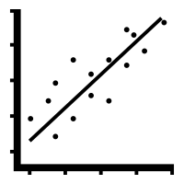
Models
Shaun
Classification and Regression Trees (CART)
Linear Regression Model
Notes:
I will be talking about the models which we used. We used
cart for determining which group of clients were the most likely to churn and we used
linear regression model to find out the profile of clients who were most likely to invest in each product

Slide 30
CART
Shaun
Churn
86 NC, 113 C
100%
Legend
NC: No churn
C: Churn
Number of days since last transaction < 201 days
No
Yes
Churn
64 NC,110 C
87%
Estimated salary >= $159,000
No churn
22 NC, 3 C
13%
Yes
No
No churn
23 NC, 8 C
16%
Churn
41 NC, 102 C
72%
Notes:
Cart model on 199 datapoints
First node contains all data points 86nc vs 113c, which is 100% of datapoints
First condition: Number of days since last transaction < 201 days
If true, the clients most likely nc with 22 vs 3, 13% of datapoints
If false, majority churn 110 vs 64, 87% of data points
Next ,further split the clients on the right, condition annual salary 159k
If true, clients most likely nc 23 vs 8,
If false meaning estimate salary is less than 159k, majority will churn

Slide 31
CART
Shaun
Churn
86 NC, 113 C
100%
Legend
NC: No churn
C: Churn
Number of days since last transaction < 201 days
No
Churn
64 NC,110 C
87%
Estimated salary >= $159,000
No
102/143 = 71% accuracy
Churn
41 NC, 102 C
72%
Notes:
Last node shows the group of clients most likely to churn, Number of days since last transaction more than or equal 201 and estimated salary less than 159k
Accuracy is 71%

Slide 32


Linear Regression Model
Shaun
Model predicted Emerging Market Funds investment
=
$7429.80 + $7040.60 x Male
Female
$7429.80
Male
$14770.40

Slide 33
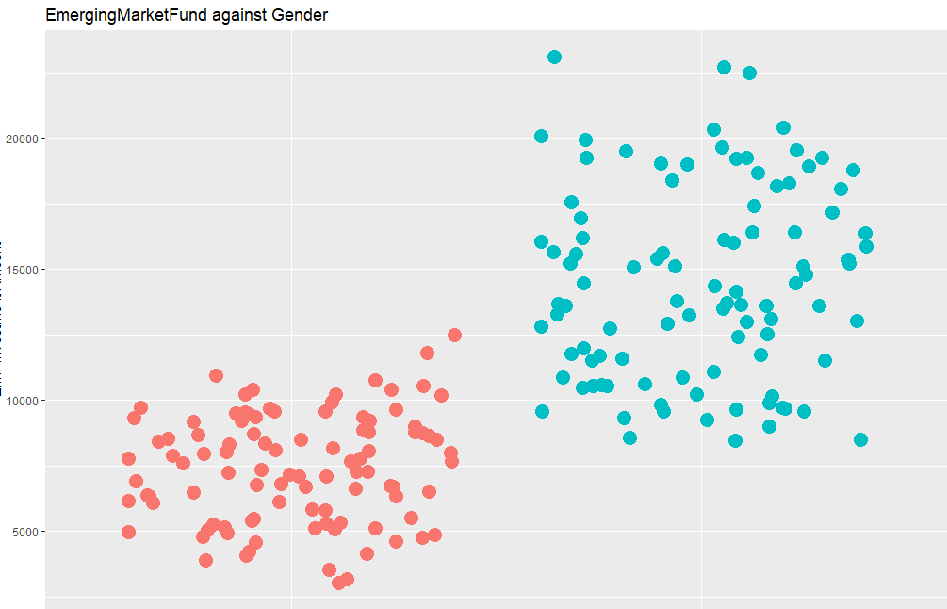
Linear Regression Model
Shaun
EMF investment amount ($)
$14770.40
$7429.80
Female
Male

Slide 34
04
CONCLUSION
Yuki

Slide 35
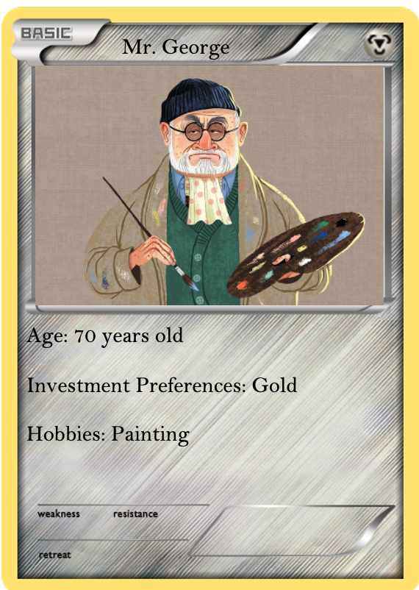
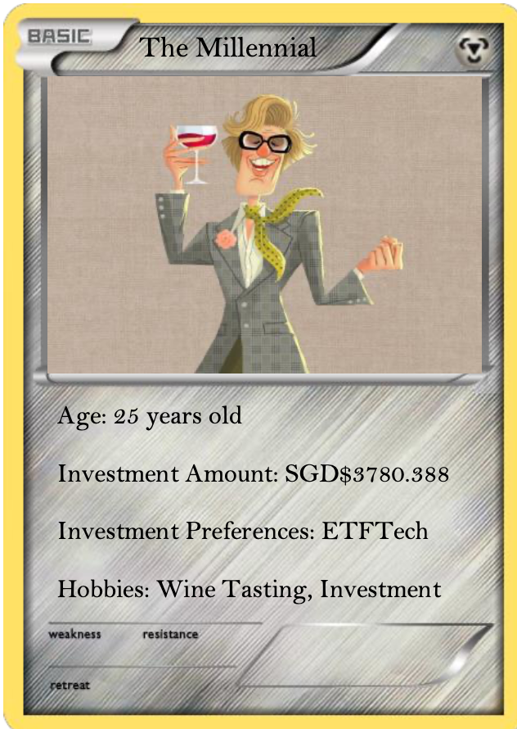
Summary
Yuki
Older clients tend to buy more Gold, while younger clients invest more in ETF Tech.
Notes:
In conclusion, read slide 35-39.

Slide 36
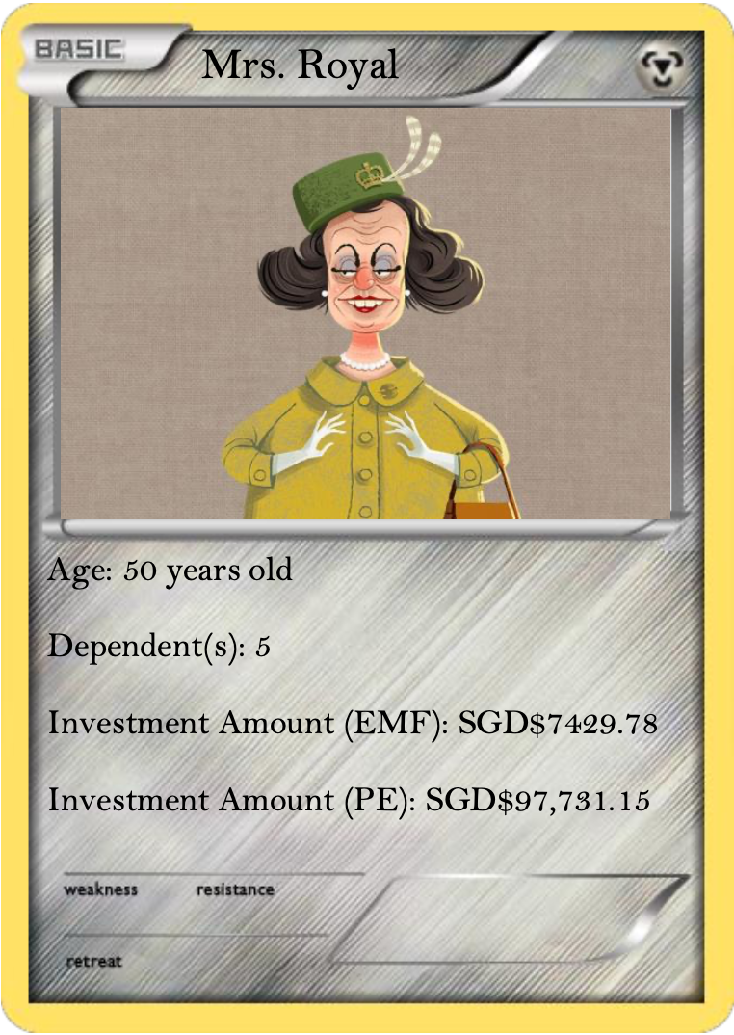
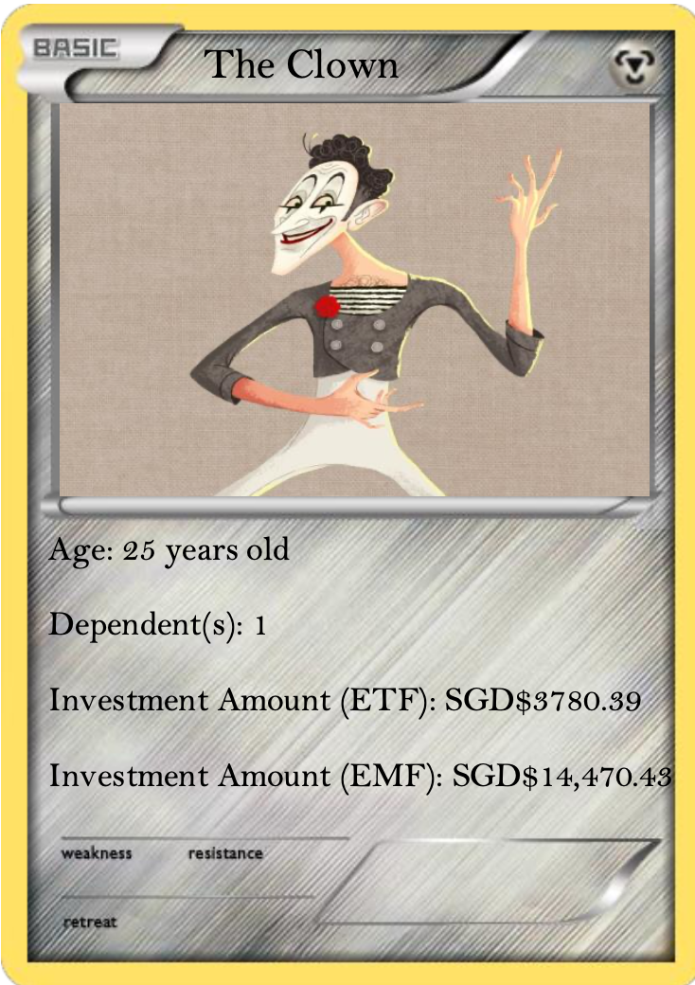
Summary
Yuki
Female clients prefers Corporate Bonds while male clients prefers Emerging Market Funds (EMF).

Slide 37
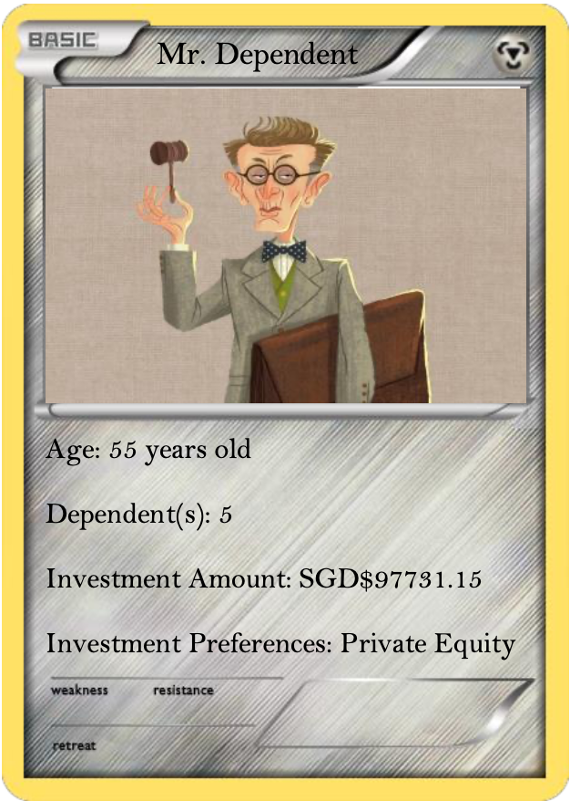
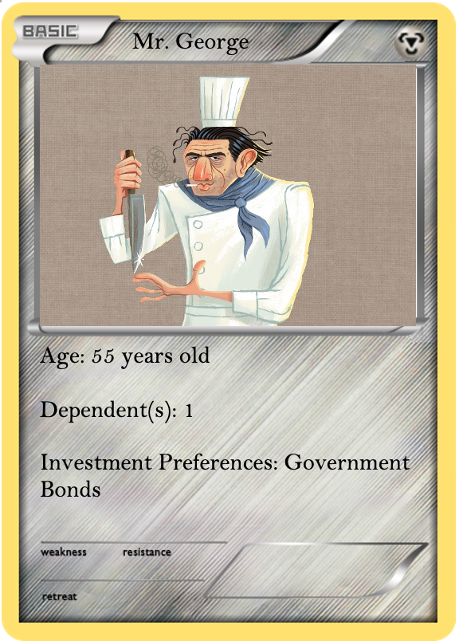
Summary
Yuki
Clients with more dependents invest more in Private Equity (PE), while clients with fewer dependents invest more in Government Bonds.

Slide 38
Summary- Robo Advisors
Yuki
Robo advisors can help pool funds of younger clients together to invest in private equity.

Slide 39


Summary- Reducing Outflows
Yuki
In order to reduce churn, White Rock has to retain inactive customers who have not made any transactions for more than 201 days and have an annual salary of less than $159,000.

Slide 40
Questions?

Slide 41
Thank You

